Slide 1


Nuveen Sales Data Analysis Project
PGDMLAI Capstone
Julian Renz

Slide 2
Tables of Contents
1. Background
2. Objectives
3. Approach
4. Results
5. Recommendations

Slide 3

1. Background
Nuveen has supported the financial futures of millions of people for over 120 years
TIAA (which owns Nuveen) ranks among the 5 biggest asset managers globally
Nuveen charges investors a percent of assets under management (AUM)
Management, sales and redemption fees increase with more asset amounts, more funds added and longer investment duration
Sales channels:
In-person salesforce (wholesalers)
Meetings and events
Telephone salesforce (internal wholesalers)
Email and direct mail marketing
Social media
Decreasing Cost of Acquisition
Cost of acquisition vs fees earned
Resource Allocation

Slide 4
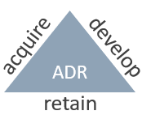

2. Objectives – Predict & Recommend on ADR
Predict next year’s sales per advisor using previous year’s data
Break the sales down into segments
Compare to actual sales and feature correlation
Predict if advisors will add funds in the next year
Find feature correlations to deciles
Examine which segments make up these deciles
A good model will point out key advisor groups and channels to focus sales efforts on, and thus help saving costs

Slide 5
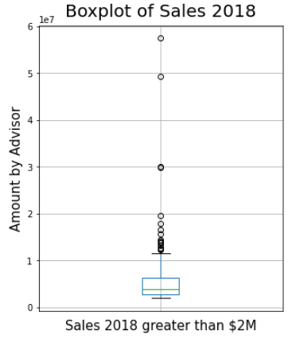
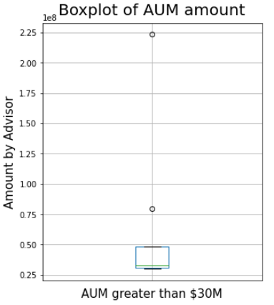
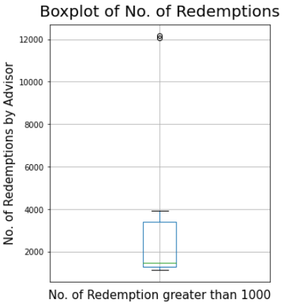
3. Many zero values & outliers may present challenges for predictions (outliers may contain valuable insights)

Slide 6
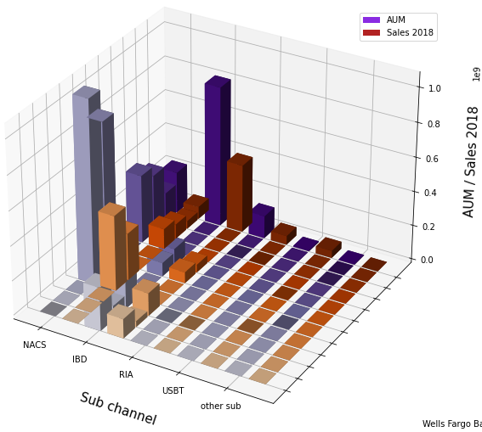

3. Massively segmented data set - Expectation to gain valuable insights by dividing data into Sub channels and largest advisor firms
e.g. Morgan Stanley and Merrill Lynch make up the greatest part of AUM/Sales within NACS

Slide 7
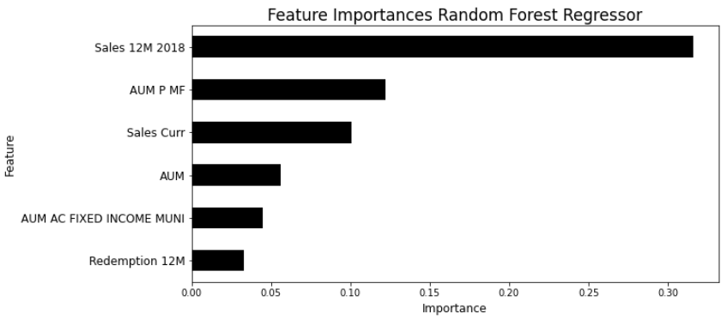
4. Regression Results - Most Important Variables condense into Sales, AUM-related and Redemption “amount-features”

Slide 8
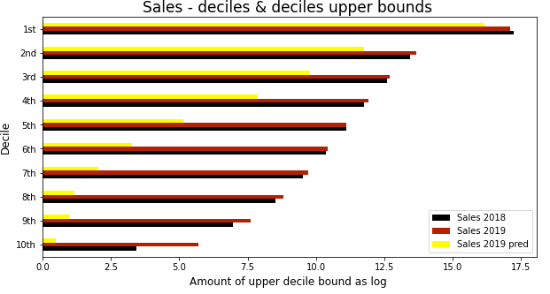
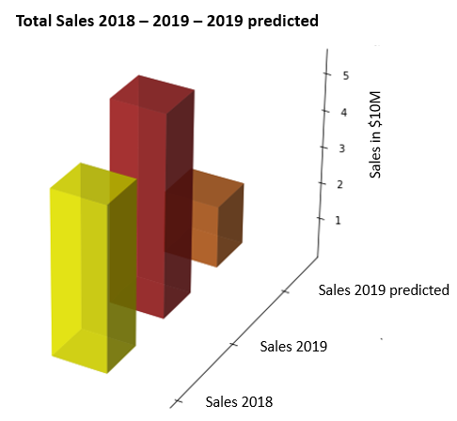
4. High-sales-deciles predicted well despite total differences in model
Model total difference actually provides valuable insights laid out in the following
The model does better in predicting the higher sales advisors
As evident in EDA, the many zero values present a challenge for prediction (underprediction)
Actual sales 2018 & 2019 have much higher counts in the lowest deciles (many zero values)

Slide 9
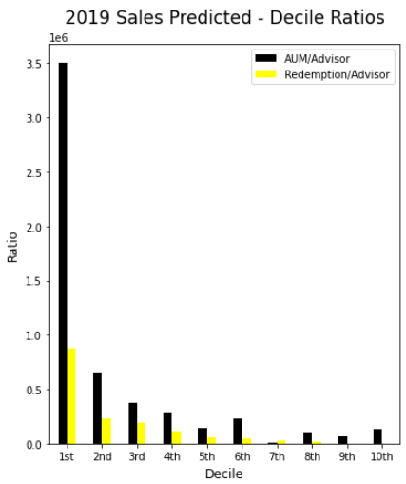
4. More active advisors also generate higher sales
Advisors in the high sales’ deciles also manage a higher AUM and have higher redemption amounts
Noteworthy: redemption is positively correlated to amount of sales
The top decile makes up about 91% of total sales predicted and its composition of sub channels and firms reflects overall segmentation of sales, too.

Slide 10
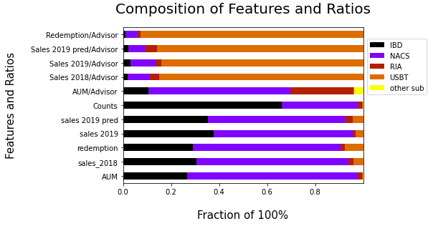
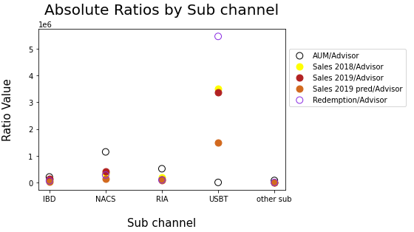
4. Great consistency of predicted/actual features and ratios with one exception
The model underpredicts high performing advisors in USBT (US Bank Private Wealth Management)
A reason for total model deviation lies here
Advisors in the smaller sub channels have a higher fraction of overall AUM (RIA), Sales & Redemption (USBT) per advisor

Slide 11
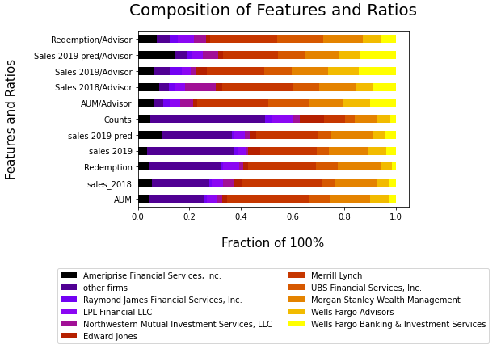
4. Relative ratios also accurate for firm segmentation
E.g. decrease in Northwestern Mutual for 2019 sales / advisor predicted correctly by model
Merrill Lynch, Ameriprise overpredicted
Wells Fargo Bank. & Fin. And Morgan Stanley perform better per advisor
Other firms have high proportion of absolute numbers, but small per advisor

Slide 12
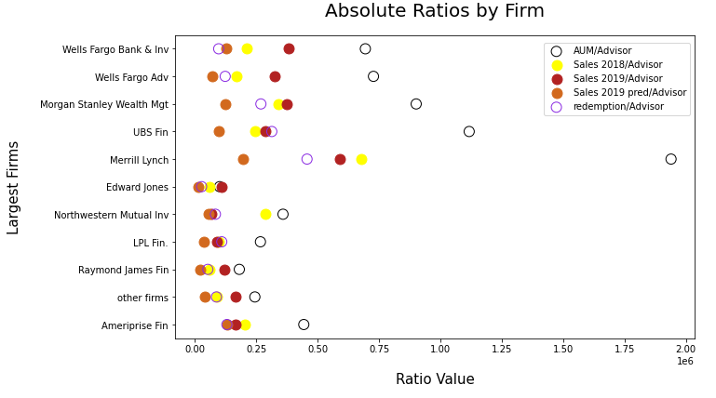
4. Absolute predicted ratios show the right trend
Overall good predictions
Higher performing advisors are underpredicted in model
Among the 10 most frequent client companies, the ones with higher sales also have higher AUM

Slide 13
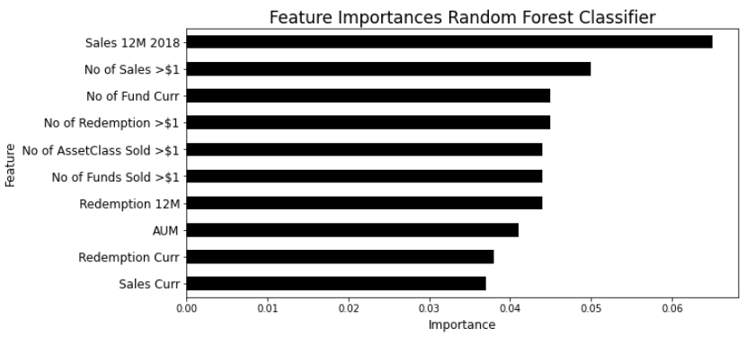
4. Classification Results - Most Important Variables are more evenly distributed and contain ‘’No. of ..” features

Slide 14
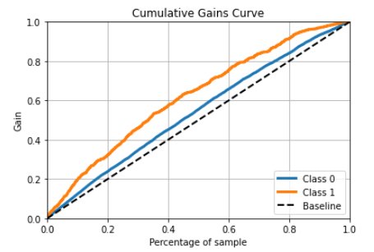
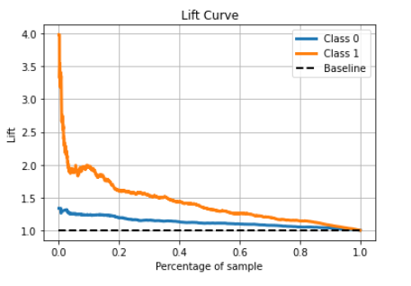
4. About 40% of advisors have a lift of 50% or higher
The model is especially helpful for Class 1 predictions with a max gain of about 20%
About 40% of the data has a lift of 50% or higher over the baseline for Class 1

Slide 15
4. Table confirms Lift plot insight with exactly 38% of advisors at 49% cum. lift
Decile | Number | Lift_positive | Lift_positive Index | Num. Cum. | Cum. Lift positive | Cum. Lift
1st | 251 | 0.49 | 91% | 251 | 0.49 | 91%
2nd | 250 | 0.4 | 56% | 501 | 0.45 | 74%
3rd | 250 | 0.38 | 48% | 751 | 0.42 | 65%
4th | 250 | 0.26 | 2% | 1,001 | 0.38 | 49%
5th | 250 | 0.19 | -26% | 1,251 | 0.34 | 34%
6th | 337 | 0.25 | -2% | 1,588 | 0.32 | 27%
7th | 163 | 0.22 | -14% | 1,751 | 0.31 | 23%
8th | 250 | 0.2 | -22% | 2,001 | 0.30 | 17%
9th | 250 | 0.11 | -57% | 2,251 | 0.28 | 9%
10th | 251 | 0.06 | -77% | 2,502 | 0.26 | 0%
Total | 2,502 | 0.26
Average probability of adding a fund is 26%
The top 3 deciles carry the whole population (above average lift index)
This means that for the top 751 advisors, 488 (65%) more correct predictions on funds added can be made as opposed to randomly contacting these advisors
Except for the lowest 2 deciles it is worth pursuing the probability indication with the associated advisors (i.e. apply sales measures beyond mass email blasts)

Slide 16
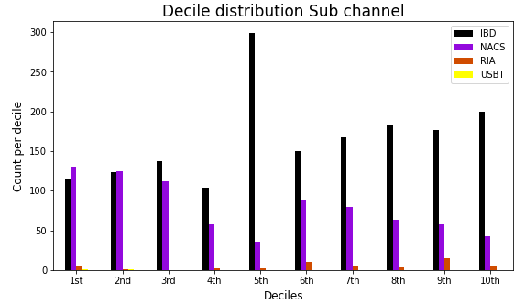
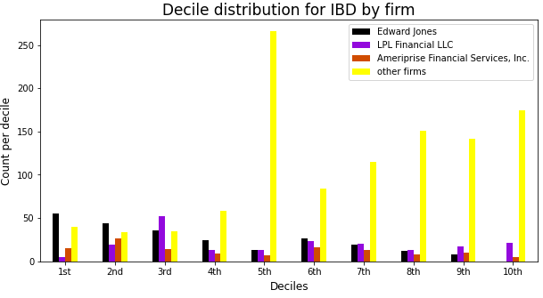
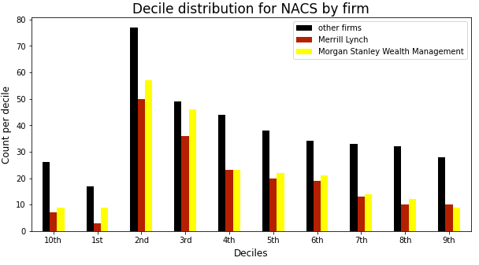
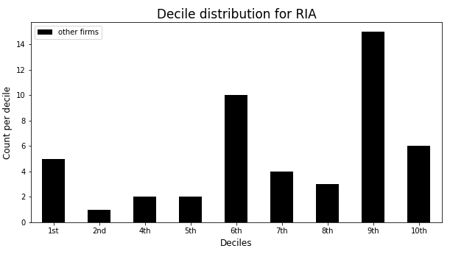
4. Smaller firms gained through IBD are of the lower probability type, compared to NACS
IBD has more advisors in the lower deciles
Clients of the largest firms are more likely to add a fund within IBD
NACS has higher quality “other firms” (allocate more resources)
RIA tends to have more advisors that don’t add sales

Slide 17
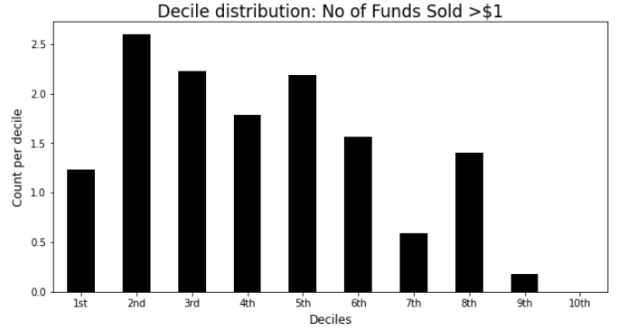
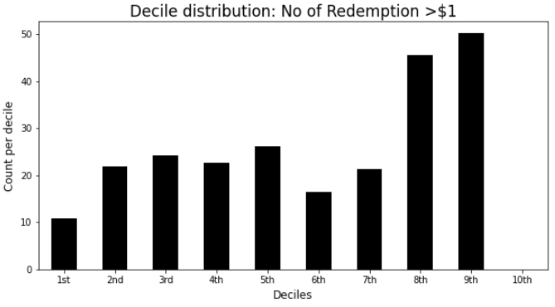
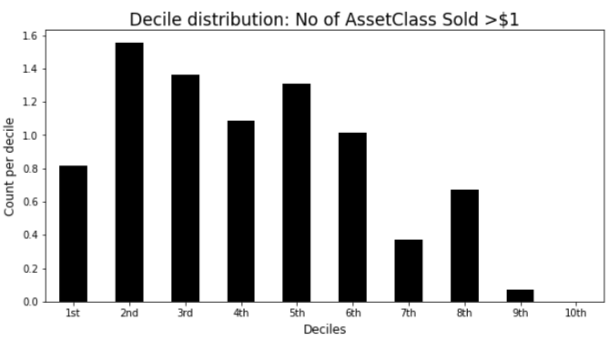
4. “Number of..” features classify funds-added better
Only 3 variables show a clear trend
If advisors sold more funds / asset classes or have less no. of redemptions in 2018, they are more likely to add a new fund in 2019
No. of redemption is negatively correlated

Slide 18
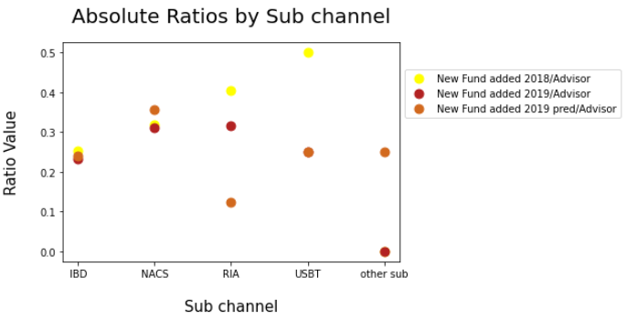
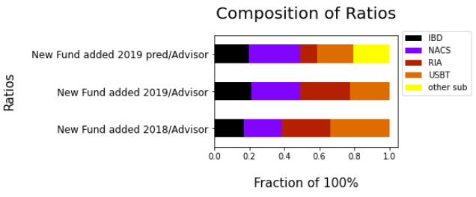
4. Average ratios don’t show much differences, but NACS tends do better than IBD here ,too
Higher sensitivity for ratios with low counts (USBT, other sub)
RIA is underpredicted, but the direction is predicted correctly (i.e. less funds added per advisor in the following year)

Slide 19
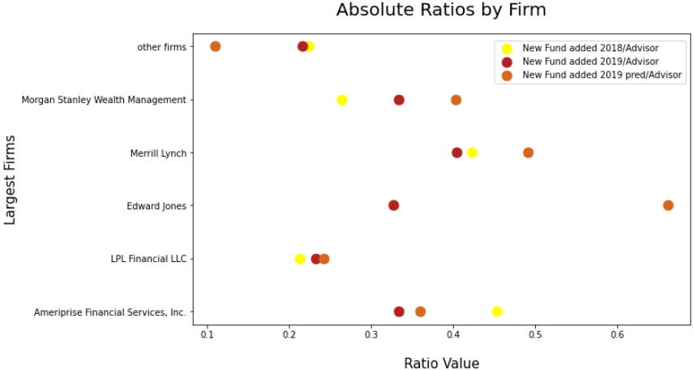
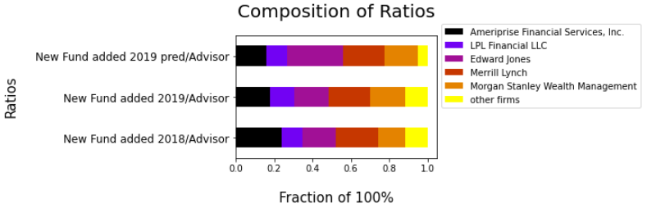
4. About half of the big firms are more likely to add a fund, but higher sensitivity of results
Relative ratios are well predicted
Other firms less likely to add a fund on average
Morgan Stanley, Merrill Lynch, Ameriprise and Edward Jones advisors are more likely to add a fund
Edward Jones is overpredicted

Slide 20
5. Recommendations I-III
Pay attention to previous year’s sales, redemption and AUM for sales prediction.
Relative segment ratios and overall direction are very accurate predictors, more than the exact absolute amount because of the many zero values.
In-person or phone marketing for high sales predictions, for high probability deciles, for the RIA channel (high AUM) and definitely the USBT outliers!
If advisors made high sales or had high AUM the previous year, don’t put resources into preventing redemptions.
Redemptions are positively correlated to generating sales and bring in fees, too.

Slide 21
5. Recommendations IV-VII
Number of redemptions is negatively correlated to funds added.
2 more variables to monitor during the year for predicting funds added: Number of funds and asset classes sold (positively correlated).
Amount features more relevant to sales, “Number of features” more relevant for funds-added predictions.
This is logical, marketing has to keep this in mind when contacting advisors.
Create virtual training sessions for low advisor ratios (smaller) firms.
Nourish the relationship with big name firms, and nurture smaller firms within NACS as these have more potential.

Slide 22
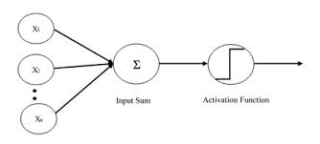


Thank you !

Slide 23
Appendix - Data Processing
Data: 10005 advisors
 | Sample Features
Transaction Data 2018 | no. & amt of funds & asset classes sold & redeemed, AUM of different products
Transaction Data 2019 | 12M sales & no. funds added
Firm Information | Firm names, Sales (Sub-) Channels
Sub channels | IBD 6679, NACS 3075, RIA 219, USBT 16, other Sub channels 16
One-Hot Encoding
Criteria for firms: Largest by number of advisors (most data points)
 | # Sub channels | # Channels | # Firms
Regression | 4 | -- | 10
Classification | 4 | 4 | 5
Preliminary Data Operations
Merging of DataFrames
Convert redemption_12M and redemption_curr to positive values
Setting all remaining negative values in DataFrame to zero
Sales_curr not added to sales_12M as assumed last month relevant

Slide 24
Appendix - Feature & Model Selection
Feature Selection | Features | Heatmap (I) (corr>0.59) | Recursive Feature Elimination (RFE) (II) | RF Feature Importance (III) <0.01 | Non-categorical features removed (count: I+II+III>1)
Regression | 52 | 16 | 26 (Linear Regression) | 7+ all categorial | 10
Classification | 57 | 16 | 26 (RF) | 15 + 12 categorial | 9
Model Selection (Regression)
Model Selection (Classification)
Method | Base Model | RF | RF alt.
Data | SS, only ‘Sales 2018’ | PT, 42 features | PT, 6 features (feat. Imp.>0.03), (III)
Model | LR | Max_depth=9 | Max_depth =9
R2 | 0.33 | 0.52 | 0.53
RMSE | 0.66 | 0.47 | 0.48
Avg CV=5 | 0.36 | 0.51 | 0.49
Other well performing regressors modeled: AdaBoost, XGBoost, NN Other effective Data Preparation methods: PCA
Method | RF | RF alt.
Data | SMOTE (ratio=0.35), PT, 48 features | SMOTE()PT, 10 features (feat. Imp.>0.03),(III)
Param. | Max_depth=13 | Max_depth =13
Validation Score (Test Data) | 0.76 over 0.66 (Class 0 ratio) | 0.74 over 0.64 (Class 0 ratio)
Avg CV=5 | 0.74 | 0.74
Other well performing classifiers modeled: Boosting Classifiers, NN Other effective Data Preparation methods: RandomOverSampler
Random Forest RF, Linear Regression LR, StandardScaler SS, PowerTransformer PT NN Neural Network

Slide 25
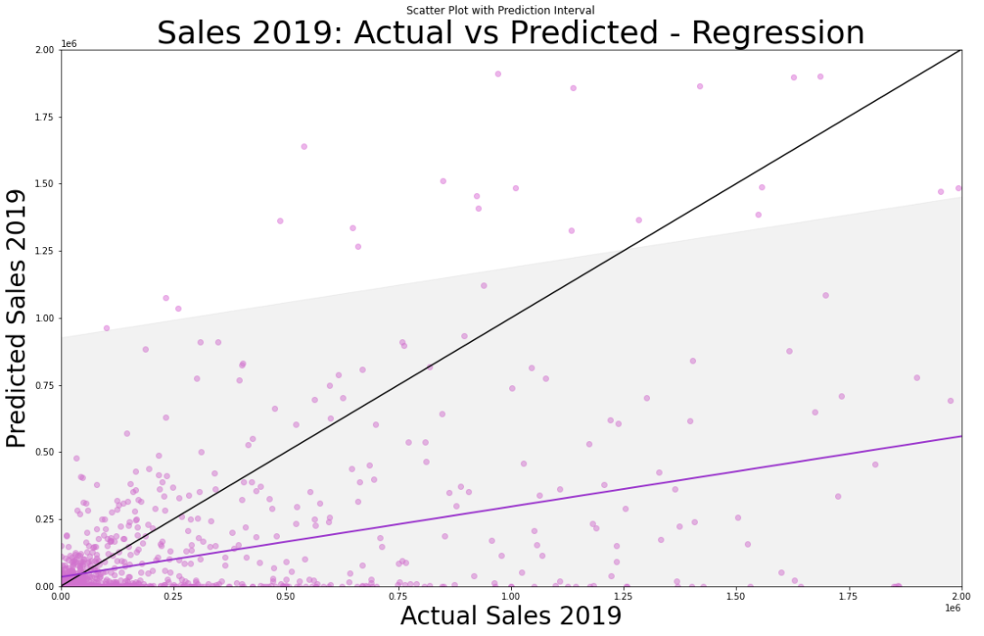
Appendix - Actual vs predicted sales show some values are underpredicted but most values lie in prediction interval
Graph shows actual vs predicted values for sales 2019
Black line shows ideal trend
Orchard line shows predicted trend
Shaded area shows predicted interval
A single new advisor predicted is expected to lie in this interval 95 out of 100 times
For the data given, this means that overpredicted values are scarce
Some points are underpredicted, these are often advisors with zero 2018 sales

Slide 26
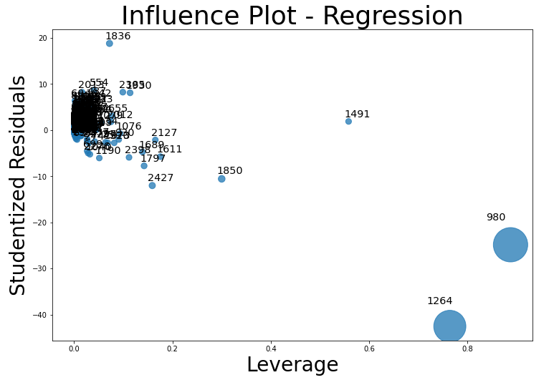
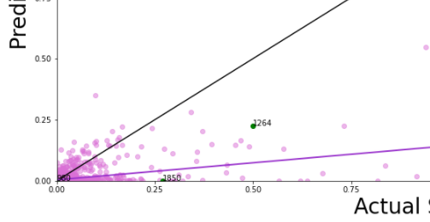
Appendix – Examining the removal of regression leverage points to improve model metrics
Scatter plot (Actual-Predicted sales) snippet: Tracking Leverage points
 | RF w/o leverage points
R2 | 0.46
RMSE | 0.54
Avg CV=5 | 0.42
Unlike outliers, leverage points may follow the regression trend
Leverage points take extreme values in the independent variables / distort regression parameters
Two iterations of removing leverage points don’t improve the metrics, therefore these data points were kept.

Slide 27
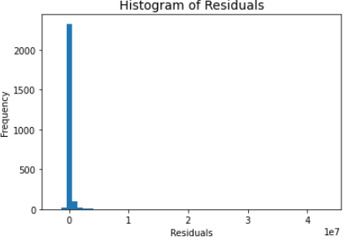
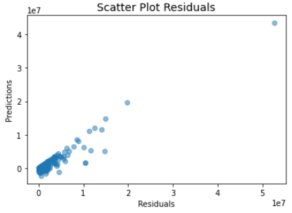
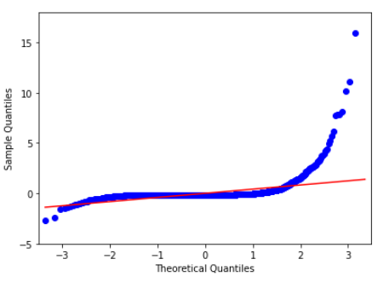
Appendix - Regression Residuals
Residuals are overwhelmingly normal by visual inspection
This adds to the validity of the model

Slide 28
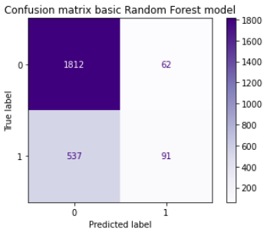
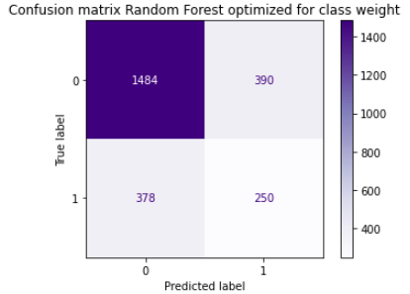
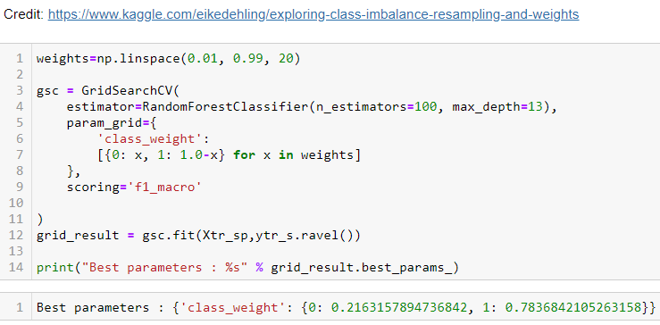
Appendix - Confusion Matrices
 | RF base
Validation Score (Test Data) | 0.76 over 0.66
Avg CV=5 | 0.74
Updated Result | RF opt
Validation Score (Test Data) | 0.69 over 0.66
Avg CV=5 | 0.70
The optimized model was used for results because of the better ability to predict 1s correctly

